Slide 1

Clothing E-commerce Store Data Analysis Report 2022

Slide 2
Objective
The objective of this project is to analyze the sales data of a clothing e-commerce store for the year 2022. We aim to uncover key insights into customer demographics, order patterns, and regional sales to inform strategic business decisions.
Technologies Used:
Excel: Used for data cleaning, organizing, and preliminary analysis.
Pivot Charts: Utilized for creating dynamic and interactive visualizations.
Conclusion: These tools facilitated efficient data analysis and visualization, enabling us to uncover valuable insights from the dataset.

Slide 3
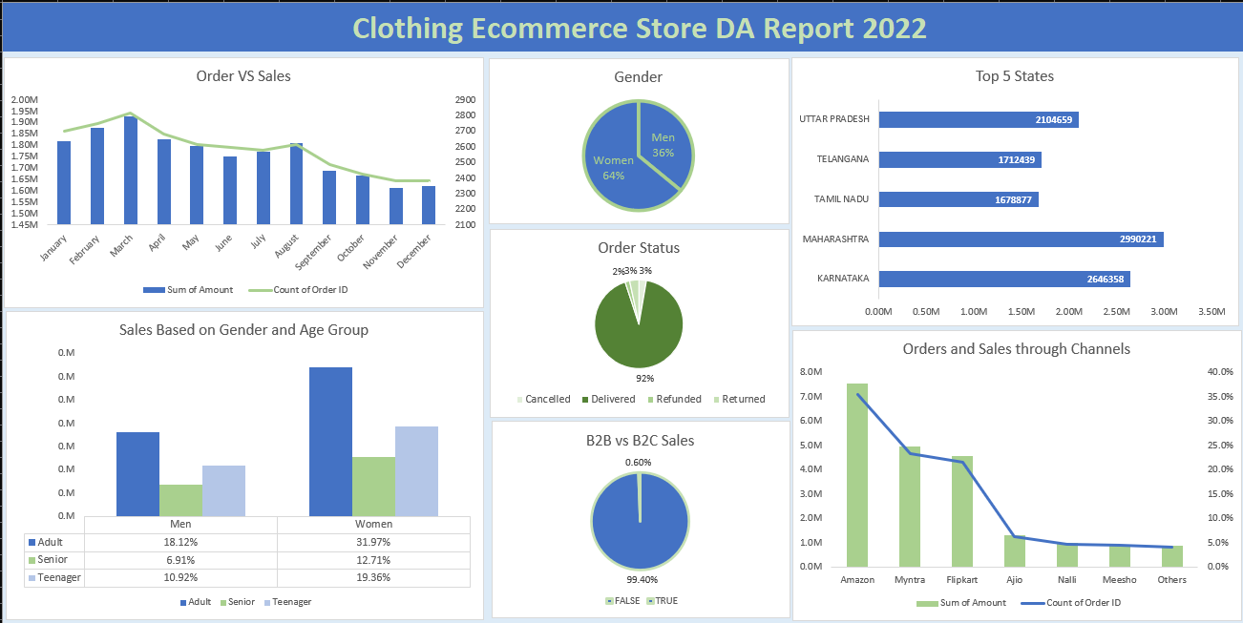
Final Dashboard

Slide 4
Chart Insights
What We Get Out of the Data:
Understanding sales trends over the year
Demographic insights into customer base
Order fulfillment status
Regional performance analysis
Channel-specific sales performance

Slide 5
Questions Addressed:
How do sales vary month-to-month throughout the year?
What is the gender distribution of our customers?
What is the age and gender breakdown of sales?
What is the status distribution of orders?
How do sales compare across different states?
What is the proportion of B2B vs. B2C sales?
How do different sales channels perform in terms of orders and revenue?

Slide 6
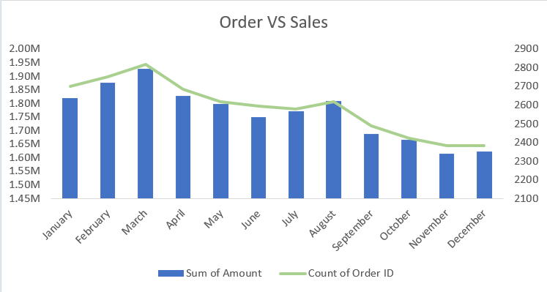
Order vs. Sales
Data Represented:
Monthly order counts and sales totals.
Numbers Presented:
March has the highest sales ($1.90M) and order count (2819), while November has the lowest sales ($1.65M) and order count (2383).
Conclusion:
Sales and order count are higher in the first half of the year and gradually decline towards the end of the year, peaking again in August.
Business Decision:
Focus marketing efforts and promotions in the latter half of the year to boost sales and order counts.

Slide 7
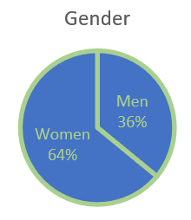
Gender Distribution
Data Represented:
Gender distribution of customers.
Numbers Presented:
Women constitute 64% of the customer base, while men make up 36%.
Conclusion:
The customer base is predominantly female.
Business Decision:
Tailor marketing strategies and product offerings to appeal more to female customers while exploring opportunities to attract more male customers.

Slide 8
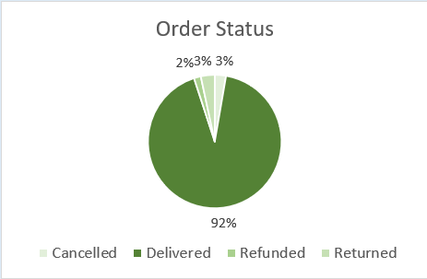
Order Status
Data Represented:
Status of orders (delivered, cancelled, refunded, returned).
Numbers Presented:
92% of orders are delivered, 3% are cancelled, 2% are refunded, and 3% are returned.
Conclusion:
The majority of orders are successfully delivered, with a small percentage facing issues.
Business Decision:
Focus on improving the return and refund processes to enhance customer satisfaction and reduce cancellations.

Slide 9
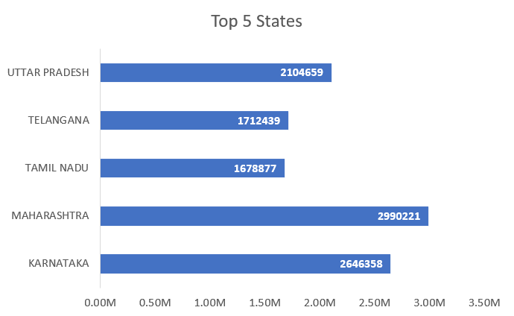
Regional Sales
Data Represented:
Sales by state.
Numbers Presented:
Maharashtra leads with $2.99M in sales, followed by Karnataka ($2.64M), Uttar Pradesh ($2.10M), Telangana ($1.71M), and Tamil Nadu (~$1.68M).
Conclusion:
Maharashtra and Karnataka are the top-performing states.
Business Decision:
Strengthen marketing and distribution channels in top-performing states and investigate potential growth opportunities in lower-performing regions.

Slide 10
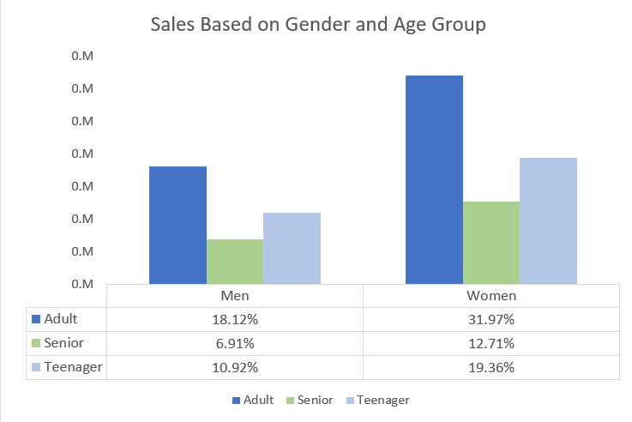
Sales by Gender and Age Group
Data Represented:
Sales distribution by gender and age group.
Numbers Presented:
Out of all buyer age groups, we have:
Women (Adult: 31.97%, Teenager: 19.36%, Senior: 12.71%)
Men (Adult: 18.12%, Teenager: 10.92%, Senior: 6.91%).
Conclusion:
Adult women are the largest customer segment.
Business Decision:
Develop targeted marketing campaigns for adult women while creating strategies to increase engagement among teenagers and seniors.

Slide 11
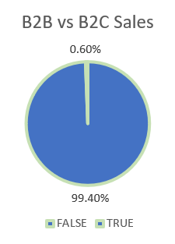
B2B vs. B2C Sales
Data Represented:
Proportion of B2B vs. B2C sales.
Numbers Presented:
B2C sales account for 99.4%, while B2B sales are 0.6%.
Conclusion:
The business is predominantly B2C.
Business Decision:
Consider expanding B2B sales opportunities to diversify revenue streams.

Slide 12
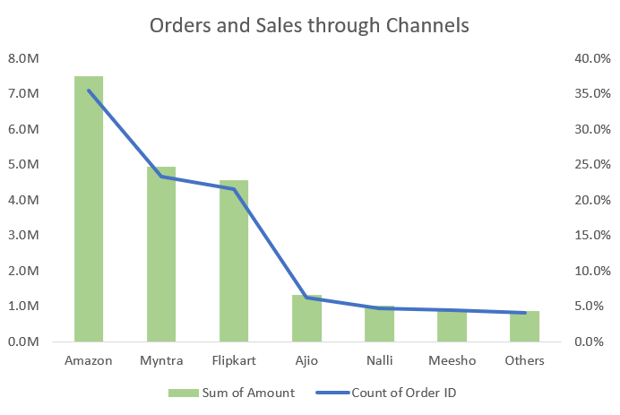
Orders and Sales through Channels
Data Represented:
Order counts and sales totals by sales channel.
Numbers Presented:
Amazon leads with $7.5M in sales and the highest order count, followed by Myntra ($4.9M), closely followed by Flipkart (~$4.6M), Ajio, Nalli, Meesho, and others.
Conclusion:
Amazon is the top-performing channel, with significant sales through Myntra and Flipkart as well.
Business Decision:
Continue to strengthen partnerships with top-performing channels while exploring ways to boost sales through other channels.

Slide 13
Possible Business Decision
Focus marketing efforts and promotions in the latter half of the year to boost sales and order counts.
Tailor marketing strategies and product offerings to appeal more to female customers while exploring opportunities to attract more male customers.
Improve the return and refund processes to enhance customer satisfaction and reduce cancellations.
Strengthen marketing and distribution channels in top-performing states (Maharashtra and Karnataka) and investigate potential growth opportunities in lower-performing regions.
Develop targeted marketing campaigns for adult women while creating strategies to increase engagement among teenagers and seniors.
Consider expanding B2B sales opportunities to diversify revenue streams.
Continue to strengthen partnerships with top-performing channels (Amazon, Myntra, and Flipkart) while exploring ways to boost sales through other channels.

Slide 14
Final Conclusion & Overall Insights
The analysis of the clothing e-commerce store's sales data for 2022 has revealed several key insights. Sales trends indicate a peak in the first half of the year, with a significant female customer base. The majority of orders are successfully delivered, with Maharashtra and Karnataka being the top-performing states. Adult women are the largest customer segment, and the business is predominantly B2C with Amazon leading as the top sales channel. These insights highlight the importance of targeted marketing strategies, improving customer satisfaction processes, and exploring new sales opportunities to drive growth.

